Slide 1
Operating Systems and The Cloud
David E. Culler
CS162 – Operating Systems and Systems Programming
Lecture 39
December 1, 2014
Proj: CP 2 12/3

Slide 2
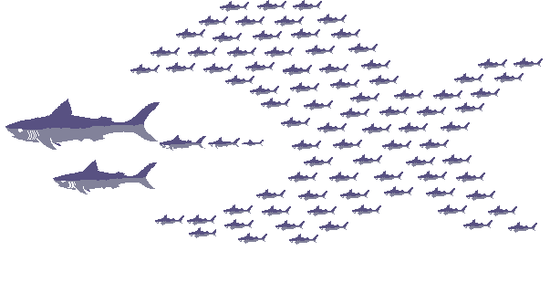
Goals Today
Give you a sense of kind of operating systems issues that arise in The Cloud
Encourage you to think about graduate studies and creating what is out beyond what you see around you …

Slide 3
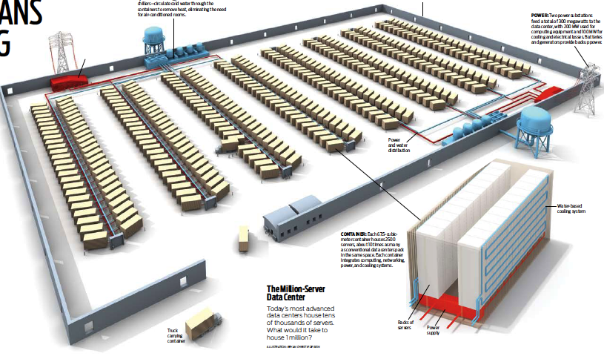

The Datacenter is the new Computer ??
“The datacenter as a computer” is still young
Complete systems as building blocks (PC+Unix+HTTP+SQL+ …)
Higher Level Systems formed as Clusters, e.g., Hadoop cluster
Scale => More reliable than its components
Innovation => Rapid (ease of) development, Predictable Behavior despite variations in demand, etc.
?
=
Notes:
During the last few years many have claimed that the datacenter is the new computer. This transformation is still in its infancy.

Slide 4
Datacenter/Cloud Computing OS ???
If the datacenter/cloud is the new computer,
what is its Operating System?
Not the host OS for the individual nodes, but for the millions of nodes that form the ensemble of quasi-distributed resources !
Will it be as much of an enabler as the LAMP stack was to the .com boom ?
Open source stack for every Web 2.0 company:
Linux OS
Apache web server
MySQL, MariaDB or MongoDB DBMS
PHP, Perl, or Python languages for dynamic web pages

Slide 5
Classical Operating Systems
Data sharing
Inter-Process Communication, RPC, files, pipes, …
Programming Abstractions
Storage & I/O Resources, Libraries (libc), system calls, …
Multiplexing of resources
Scheduling, virtual memory, file allocation/protection, …

Slide 6
Datacenter/Cloud Operating System
Data sharing
Google File System, key/value stores
Apache project: Hadoop Distributed File System
Programming Abstractions
Google MapReduce
Apache projects: Hadoop, Pig, Hive, Spark, …
Nyad, Driad, …
Multiplexing of resources
Apache projects: Mesos, YARN (MapReduce v2), ZooKeeper, BookKeeper, …

Slide 7
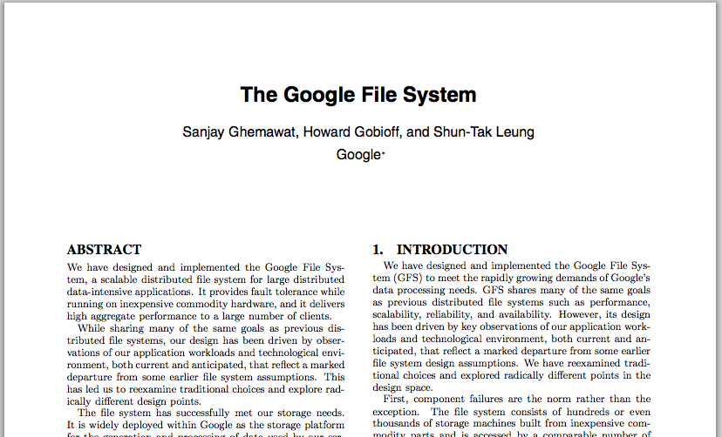
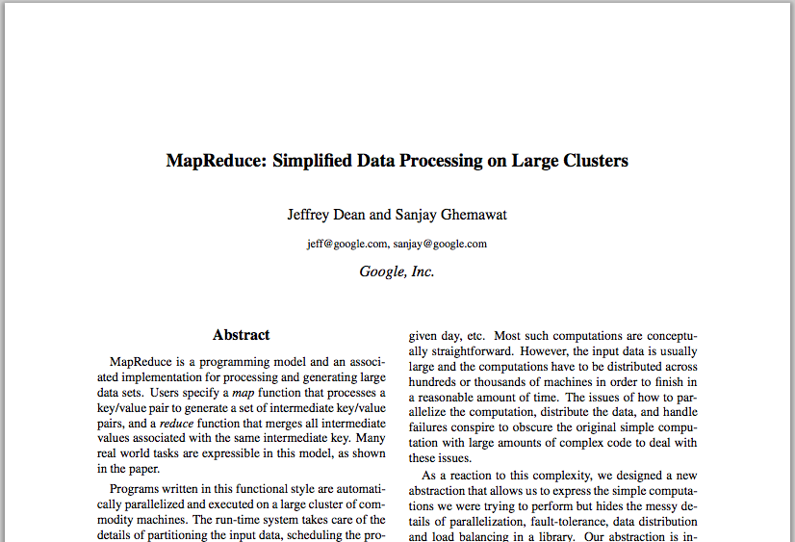
Google Cloud Infrastructure
Google File System (GFS), 2003
Distributed File System for entire cluster
Single namespace
Google MapReduce (MR), 2004
Runs queries/jobs on data
Manages work distribution & fault- tolerance
Colocated with file system
Apache open source versions: Hadoop DFS and Hadoop MR

Slide 8
GFS/HDFS Insights
Petabyte storage
Files split into large blocks (128 MB) and replicated across many nodes
Big blocks allow high throughput sequential reads/writes
Data striped on hundreds/thousands of servers
Scan 100 TB on 1 node @ 50 MB/s = 24 days
Scan on 1000-node cluster = 35 minutes
Failures will be the norm
Mean time between failures for 1 node = 3 years
Mean time between failures for 1000 nodes = 1 day
Use commodity hardware
Failures are the norm anyway, buy cheaper hardware
No complicated consistency models
Single writer, append-only data
Notes:
Large block: throughput, smaller metadata to central
Stripe: would take forever to read

Slide 9
MapReduce Insights
Restricted key-value model
Same fine-grained operation (Map & Reduce) repeated on huge, distributed (within DC) data
Operations must be deterministic
Operations must be idempotent/no side effects
Only communication is through the shuffle
Operation (Map & Reduce) output saved (on disk)

Slide 10
What is (was) MapReduce Used For?
At Google:
Index building for Google Search
Article clustering for Google News
Statistical machine translation
…
At Yahoo!:
Index building for Yahoo! Search
Spam detection for Yahoo! Mail
…
At Facebook:
Data mining
Ad optimization
Spam detection
…

Slide 11
A Time-Travel Perspective
11/2004

Slide 12
Research as “Time Travel”
Imagine a technologically plausible future
Create an approximation of that vision using technology that exists.
Discover what is True in that world
Empirical experience
Bashing your head, stubbing your toe, reaching epiphany
Quantitative measurement and analysis
Analytics and Foundations
Courage to ‘break trail’ and discipline to do the hard science

Slide 13
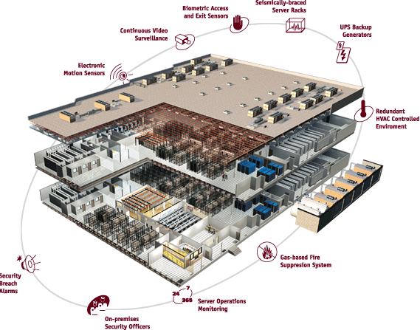
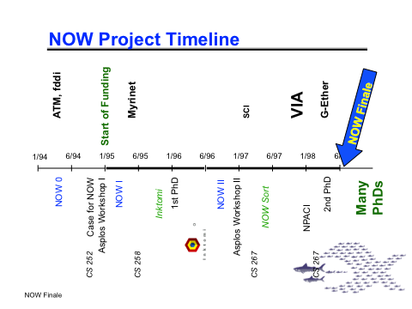
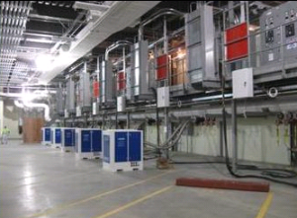

NOW – Scalable Internet Service Cluster Design
VAX clusters

Slide 14
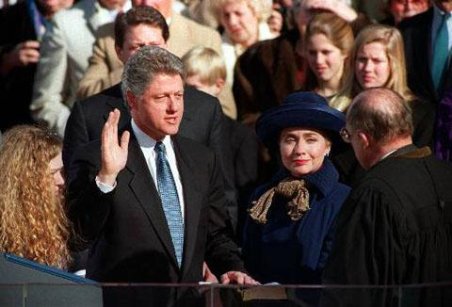

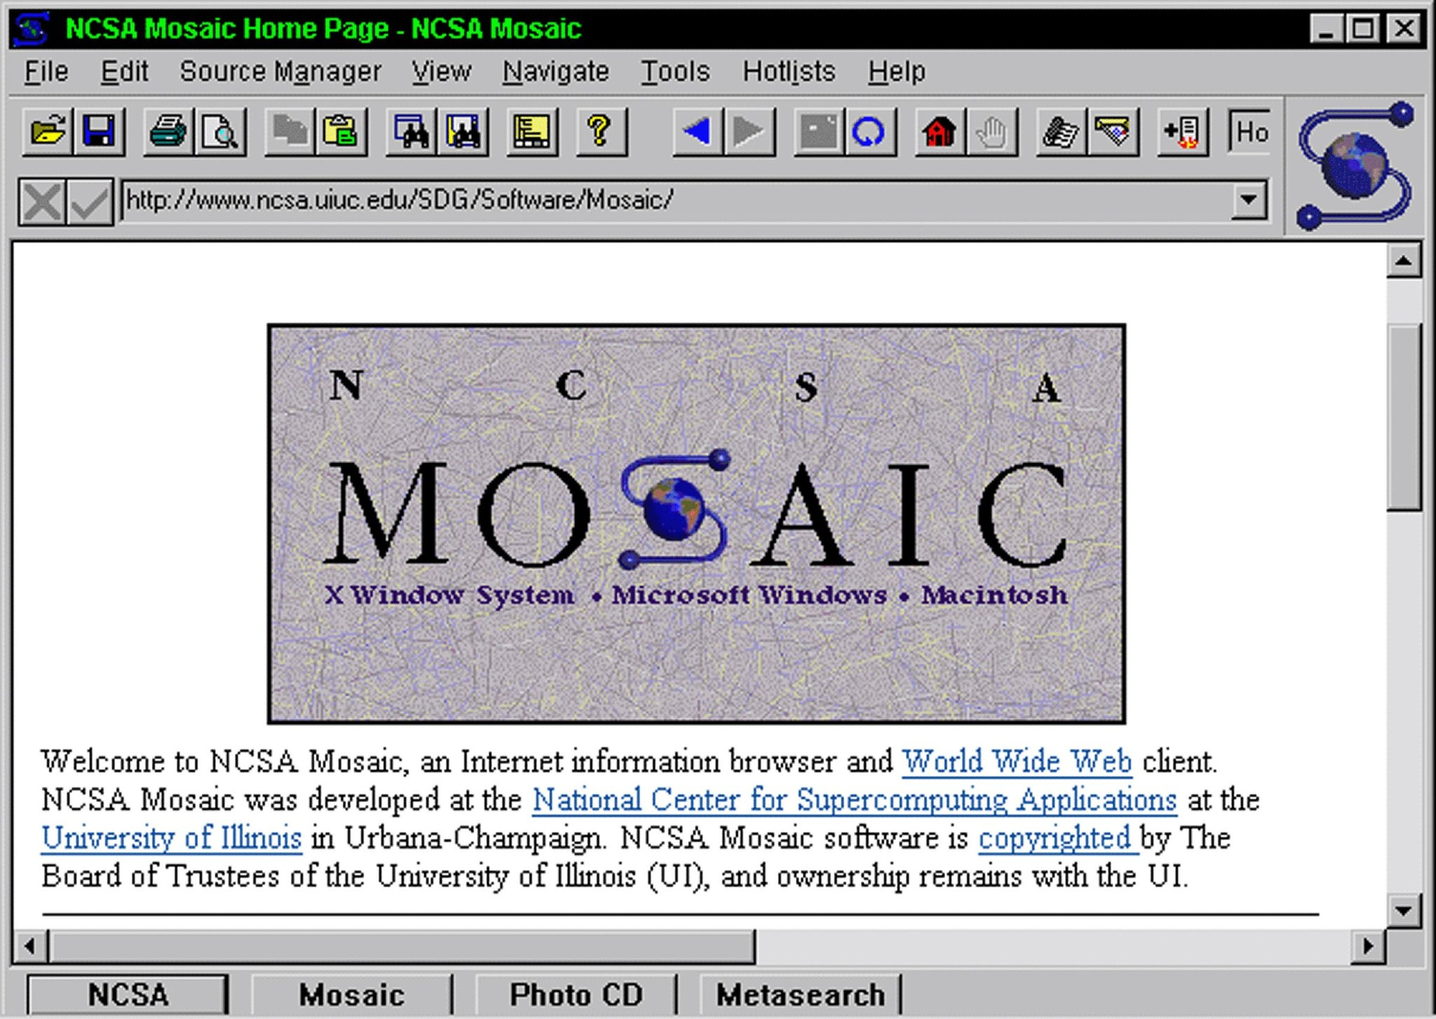
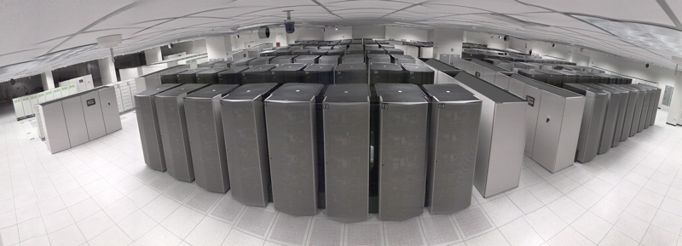
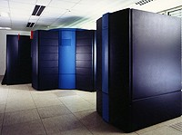
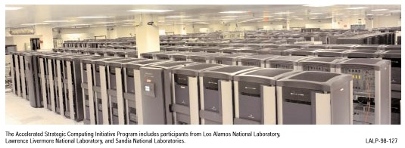
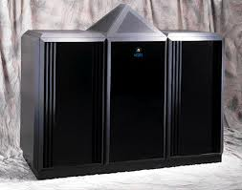
1993 Massively Parallel Processor is King

Slide 15
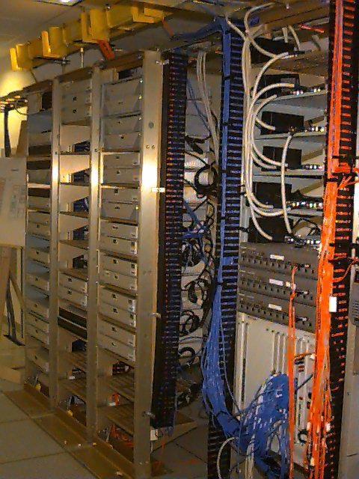
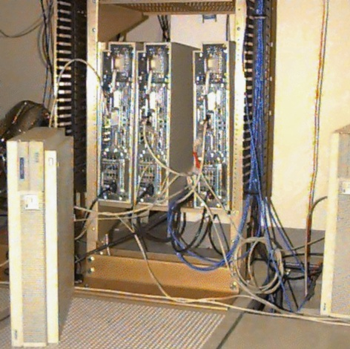
NOW – Scalable High Performance Clusters
GSC+ => PCI => ePCI …
10m Ethernet, FDDI, ATM, Myrinet, … VIA, Fast Ethernet, => infiniband, gigEtherNet

Slide 16

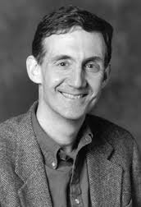
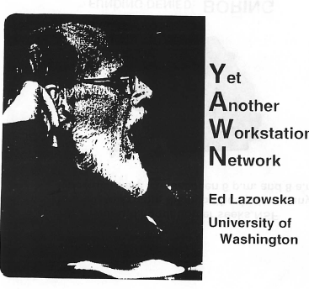
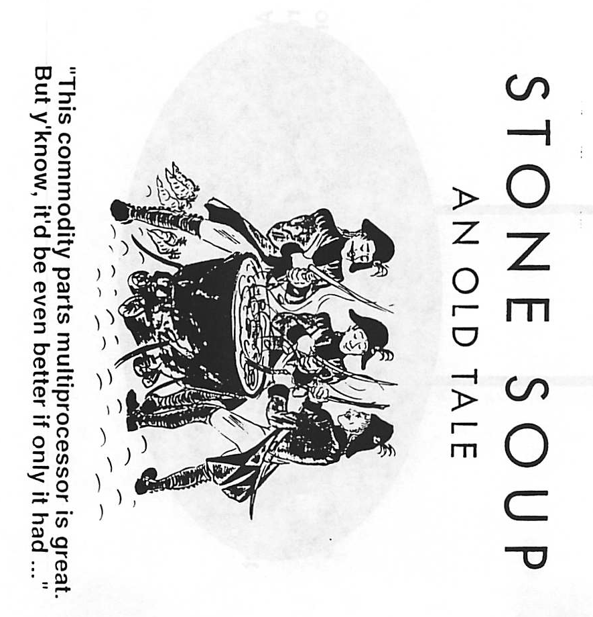
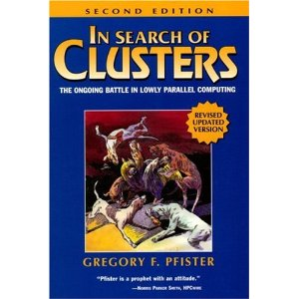
NOW – Scalable High Performance Clusters

Slide 17
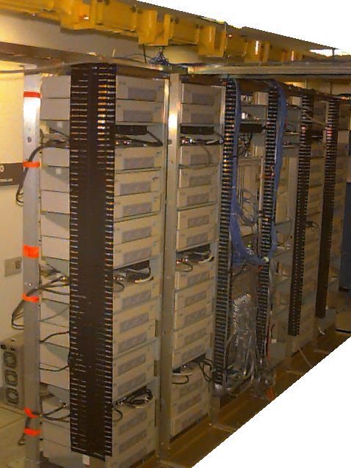
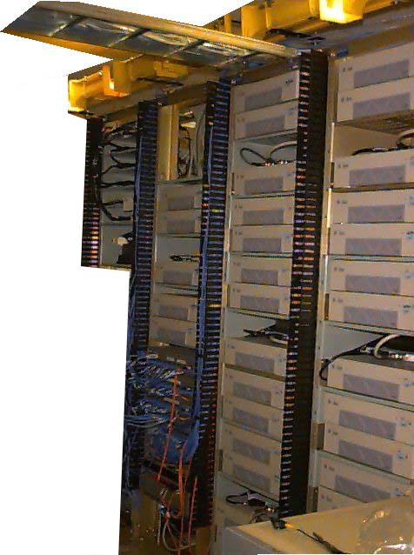
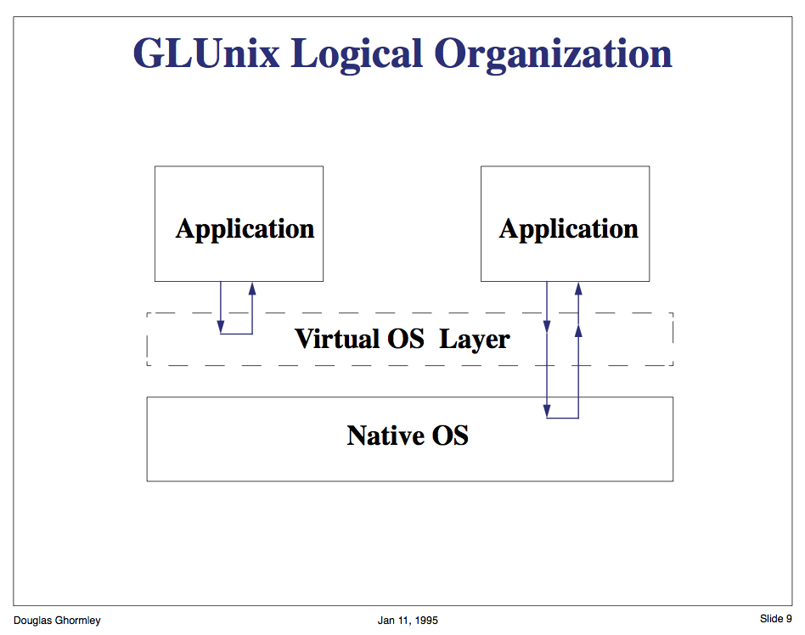
UltraSparc/Myrinet NOW
Active Message: Ultra-fast user-level RPC
When remote memory is closer than local disk …
Global Layer system built over local systems
Remote (parallel) execution, Scheduling, Uniform Naming
xFS – cluster-wide p2p file system
Network Virtual Memory

Slide 18

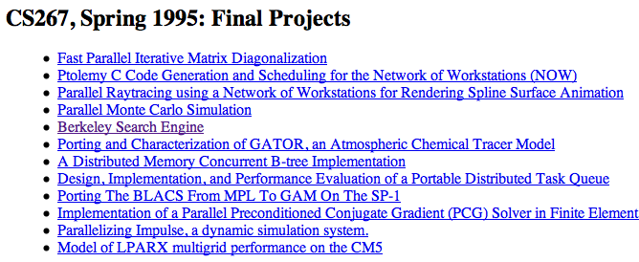

Inktomi – Fast Massive Web Search Fiat Lux - High Dynamic Range Imaging
Paul Gauthier
Lycos
infoseek
Paul Debevec
http://www.pauldebevec.com/FiatLux/movie/

Slide 19
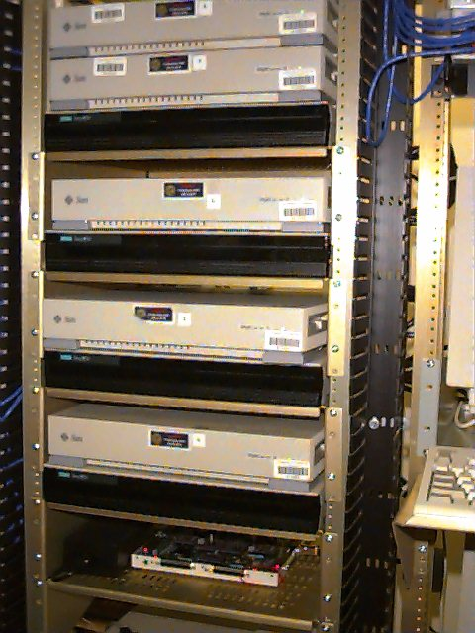

inktomi.berkeley.edu
World’s 1st Massive AND Fast search engine
1996 inktomi.com

Slide 20

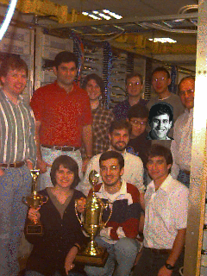
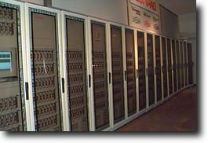
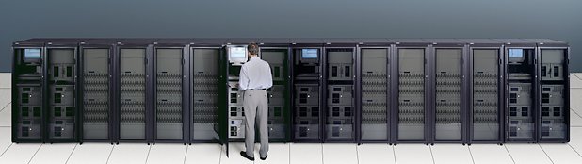
World Record Sort, 1st Cluster on Top 500
Distributed File Storage stripped over all the disks with fast communication.

Slide 21
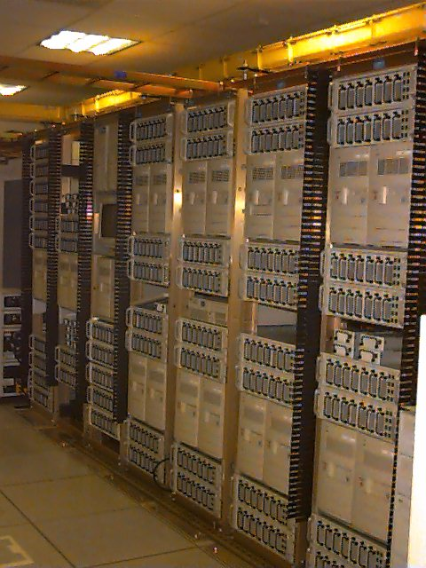
Massive Cheap Storage
Serving Fine Art at http://www.thinker.org/imagebase/

Slide 22
… google.com
N0 $’s in Search
Big $’s in caches
??? $’s in mobile
Yahoo moves from inktomi to Google

Slide 23
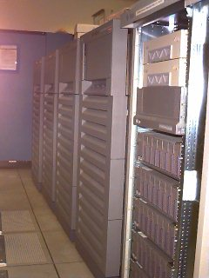
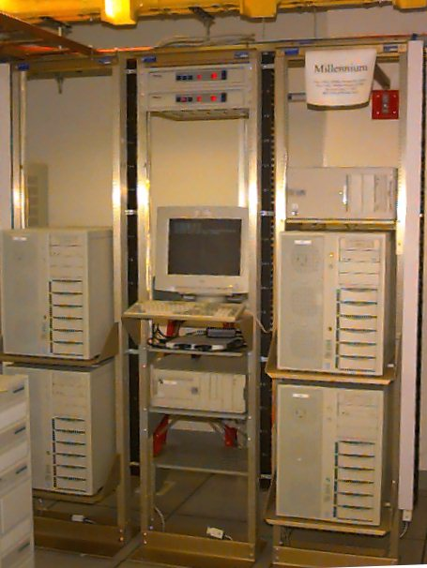
meanwhile Clusters of SMPs

Slide 24
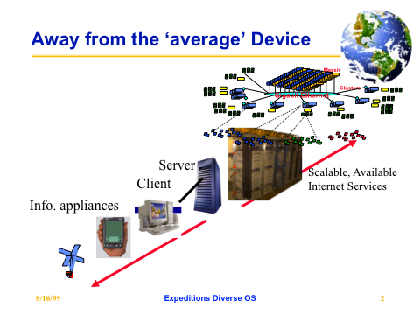
Expeditions to the 21st Century

Slide 25
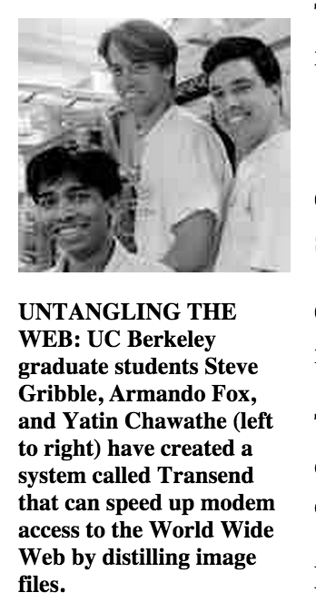
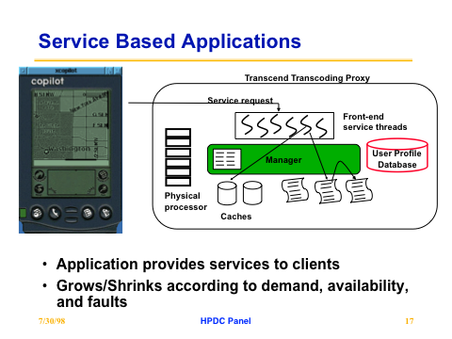
Internet Services to support small mobile devices

Slide 26
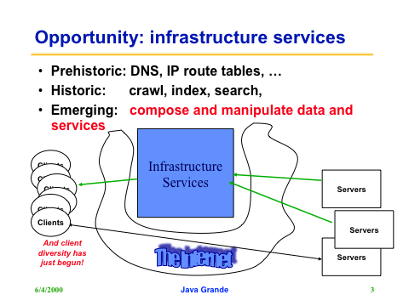
Ninja Internet Service Architecture

Slide 27
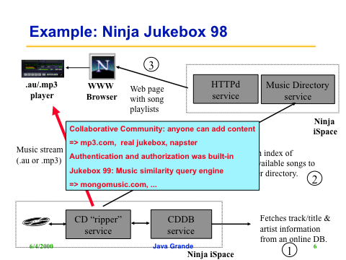
Startup of the Week …

Slide 28
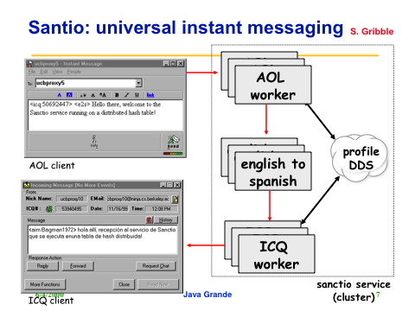
… and …

Slide 29
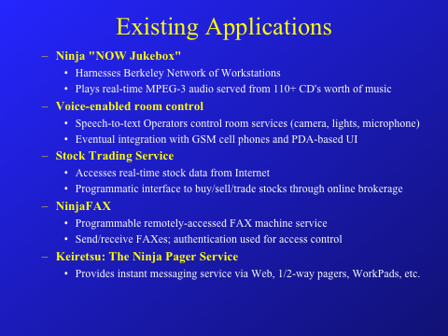
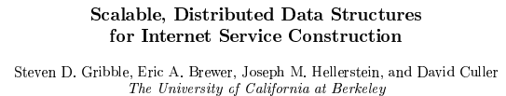
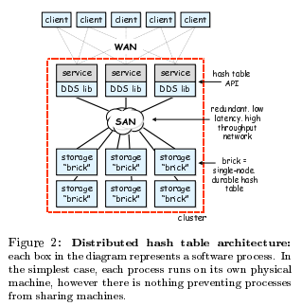
Gribble, 99

Slide 30
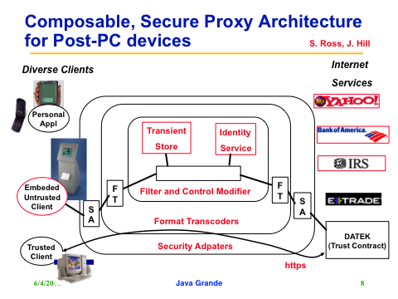
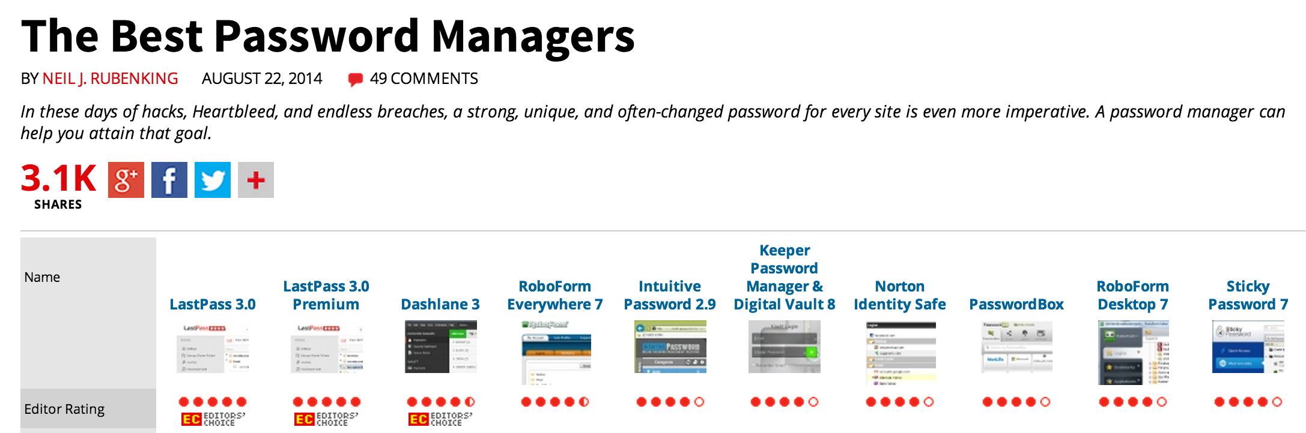
Security & Privacy in a Pervasive Web

Slide 31
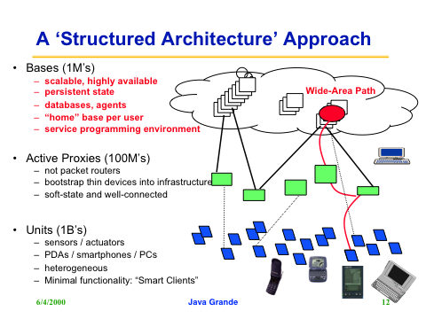
A decade before the cloud

Slide 32
99.9 Club

Slide 33
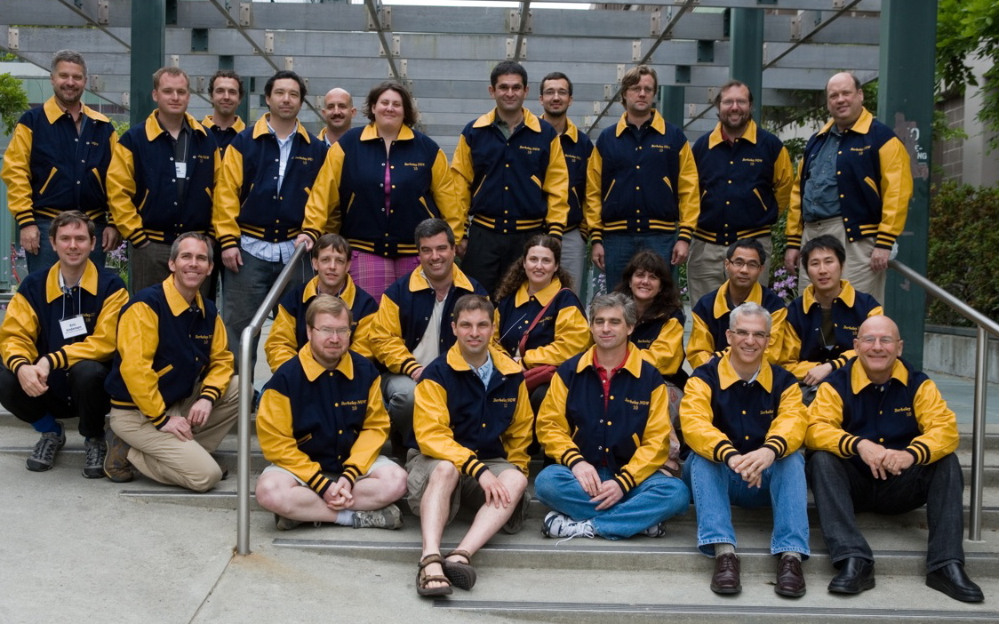
10th ANNIVERSARY REUNION 2008 Network of Workstations (NOW): 1993-98
NOW Team 2008: L-R, front row: Prof. Tom Anderson†‡ (Washington), Prof. Rich Martin‡ (Rutgers),
Prof. David Culler*†‡ (Berkeley), Prof. David Patterson*† (Berkeley).
Middle row: Eric Anderson (HP Labs), Prof. Mike Dahlin†‡ (Texas), Prof. Armando Fox‡ (Berkeley), Drew Roselli (Microsoft), Prof. Andrea Arpaci-Dusseau‡ (Wisconsin), Lok Liu, Joe Hsu. Last row: Prof. Matt Welsh‡ (Harvard/Google), Eric Fraser, Chad Yoshikawa, Prof. Eric Brewer*†‡ (Berkeley), Prof. Jeanna Neefe Matthews (Clarkson), Prof. Amin Vahdat‡ (UCSD), Prof. Remzi Arpaci-Dusseau (Wisconsin), Prof. Steve Lumetta (Illinois).
Google
Google
Google
Google
*3 NAE members
†4 ACM fellows
‡ 9 NSF CAREER Awards
Notes:
RAID project led to disk array products from many companies
+ 5 tenured faculty
NOW project led to large scale clusters of PCs used by many Internet companies
+ 8 tenured faculty

Slide 34
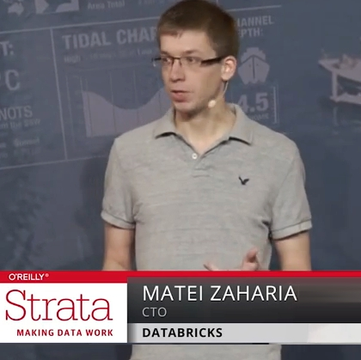
Time Travel
It’s not just storing it, it’s what you do with the data

Slide 35
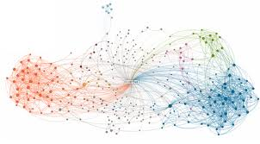
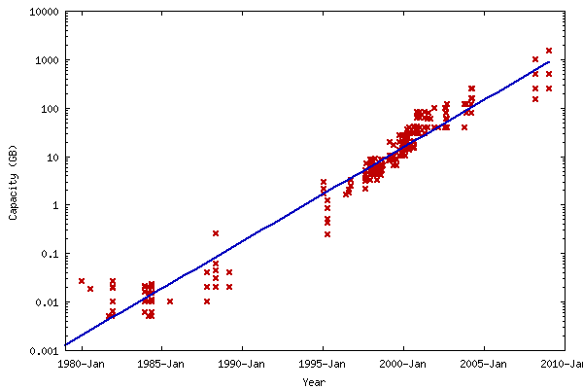
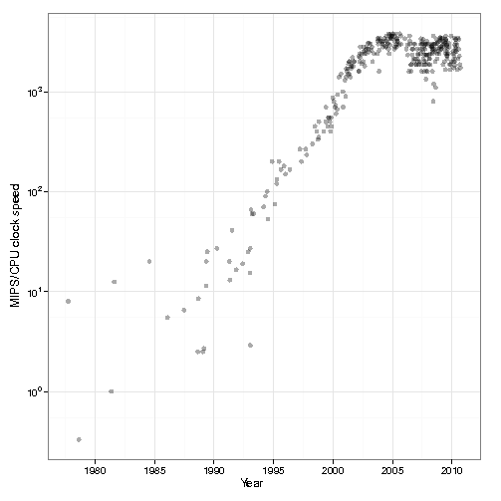
The Data Deluge
Billions of users connected through the net
WWW, Facebook, twitter, cell phones, …
80% of the data on FB was produced last year
Clock Rates stalled
Storage getting cheaper
Store more data!

Slide 36
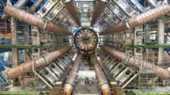
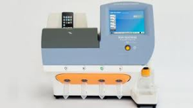
Data Grows Faster than Moore’s Law
Projected Growth
Increase over 2010

Slide 37
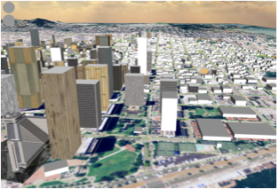


Complex Questions
Hard questions
What is the impact on traffic and home prices of building a new ramp?
Detect real-time events
Is there a cyber attack going on?
Open-ended questions
How many supernovae happened last year?
Notes:
Finally, we want to use data to ask complex questions, such as is what is the impact on traffic and home prices on building a new highway ramp.
Or we want to detect real-time events, such as is there a cyber attack qoing on?
Or we want to answer open ended questions, such as how many supernovae happened last year?

Slide 38
MapReduce Pros
Distribution is completely transparent
Not a single line of distributed programming (ease, correctness)
Automatic fault-tolerance
Determinism enables running failed tasks somewhere else again
Saved intermediate data enables just re-running failed reducers
Automatic scaling
As operations as side-effect free, they can be distributed to any number of machines dynamically
Automatic load-balancing
Move tasks and speculatively execute duplicate copies of slow tasks (stragglers)
Notes:
Transparent: not a single line of code

Slide 39
MapReduce Cons
Restricted programming model
Not always natural to express problems in this model
Low-level coding necessary
Little support for iterative jobs (lots of disk access)
High-latency (batch processing)
Addressed by follow-up research and Apache projects
Pig and Hive for high-level coding
Spark for iterative and low-latency jobs
Notes:
Expressitivity; can however do graph algos, even simulate other parallel models (PRAM and BSP

Slide 40

UCB / Apache Spark Motivation
Complex jobs, interactive queries and online processing all need one thing that MR lacks:
Efficient primitives for data sharing
Stage 1
Stage 2
Stage 3
Query 1
Job 1
Job 2
Query 2
…
Query 3
Iterative job
Interactive mining
Stream processing

Slide 41
Spark Motivation
Complex jobs, interactive queries and online processing all need one thing that MR lacks:
Efficient primitives for data sharing
Problem: in MR, the only way to share data across jobs is using stable storage (e.g. file system) ➔ slow!
Stage 1
Stage 2
Stage 3
Query 1
Job 1
Job 2
Query 2
…
Query 3
Iterative job
Interactive mining
Stream processing

Slide 42
Examples
HDFS read
HDFS write
HDFS read
HDFS write
iter. 1
iter. 2
. . .
Input
HDFS read
query 1
result 1
query 2
result 2
Opportunity: DRAM is getting cheaper ➔ use main memory for intermediate results instead of disks
query 3
result 3
Input
. . .
Notes:
Each iteration is, for example, a MapReduce job

Slide 43

Goal: In-Memory Data Sharing
iter. 1
iter. 2
. . .
Input
query 1
one-time processing
query 2
query 3
Input
Distributed memory
. . .
10-100× faster than network and disk

Slide 44
Solution: Resilient Distributed Datasets (RDDs)
Partitioned collections of records that can be stored in memory across the cluster
Manipulated through a diverse set of transformations (map, filter, join, etc)
Fault recovery without costly replication
Remember the series of transformations that built an RDD (its lineage) to recompute lost data
http://spark.apache.org/

Slide 45




Slide 46
Berkeley Data Analytics Stack (open source software)
Cancer Genomics, Energy Debugging, Smart Buildings
In-house
Apps
BlinkDB
Sample Clean
MLBase
SparkR
Access and
Interfaces
Spark
Streaming
SparkSQL
GraphX
MLlib
Apache Spark
Velox Model Serving
Processing
Engine
Tachyon
Tachyon
Storage
HDFS, S3, …
Apache Mesos
Yarn
Resource
Virtualization

